Slide 1
Team Assignment 1
Data Analytics Tools 1
Dawodu Oluwafemi N01691874
Rajkumar Ramu N01705840
Ismail Ismail N01720388
David Lake N01698267
Om Dabhane N01710637

Slide 2
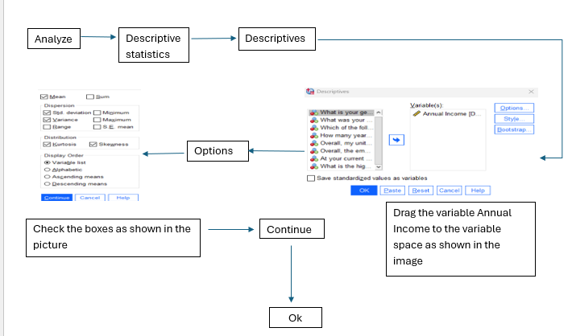
a) Determine the mean, variance, standard deviation, skew and kurtosis for annual earnings;
The process;
Open the SPSS file saved as
UsWorkers.sav and follow the steps as displayed in the image

Slide 3
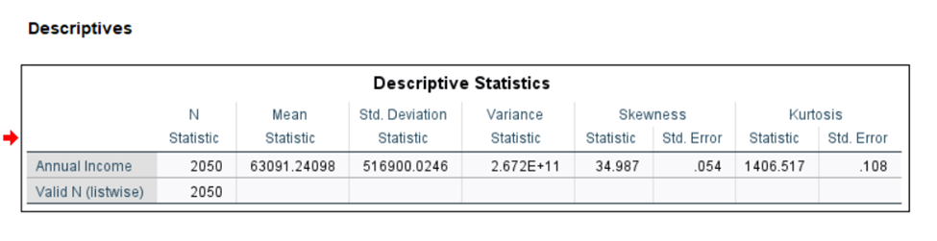
The output and the insights;
From the output table we can confirm that there are 2050 cases with 0 missing values indicating a perfect sample size for analysis .
The extremely high skewness and kurtosis suggest that the earnings distribution has significant outliers, likely due to a few individuals earning disproportionately high salaries.

Slide 4
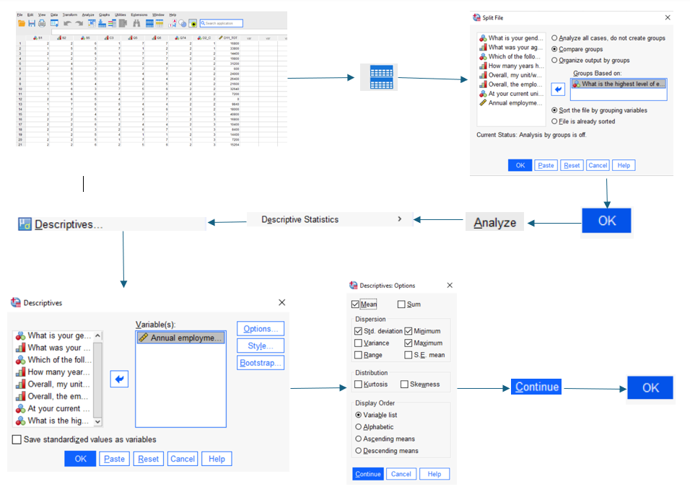
(b) Determining the average annual earnings of workers for each level of education.
The process;
Open the SPSS file saved as
UsWorkers.sav and follow the steps as displayed in the image
In the 2nd step we start from splitting the file as we only need to compare the 2 Variables. We drag the needed variables as shown in the practical images.

Slide 5
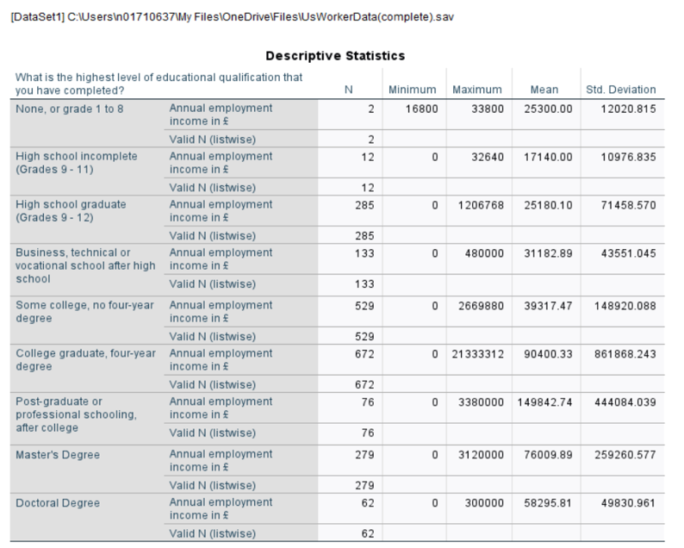
The output and the insights;
Sample size is 2,050 workers, with no missing data (0 cases excluded) and it ensures perfect sampling size for analysis.
Higher education levels generally lead to higher averages in annual income of the workers.
There is significant variation in earnings, especially at higher education levels, as indicated by large standard deviations.

Slide 6
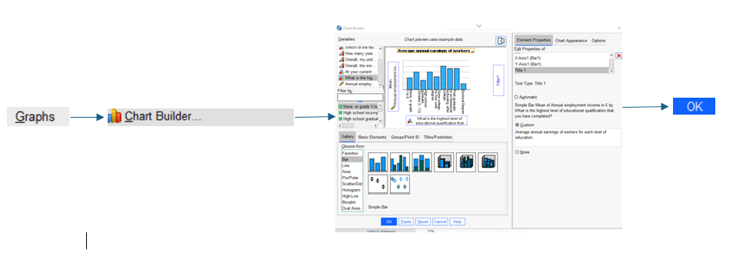
Plotting a Simple Bar Graph;
First we un - split the data in the same way we split the data in the above practical. Then we move on accordingly as shown and choose a simple bar graph by dragging it in the preview box and dragging the needed variables in X - axis and Y - Axis as needed and plot the Graph.

Slide 7
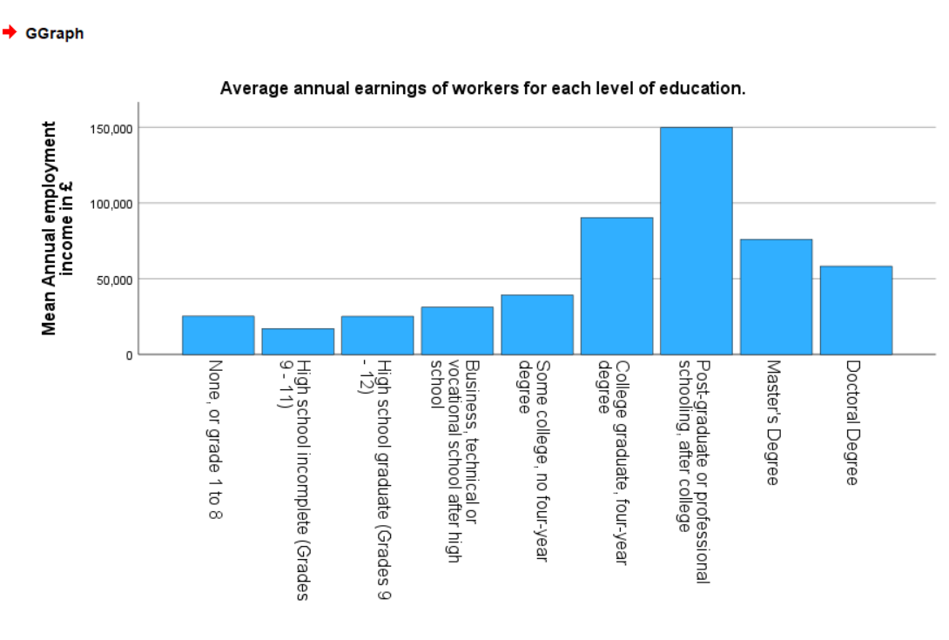
The output;
As we can see in the Graph as well that as the education level increases the mean of annual income also increases. There are less employees with Masters and Doctoral degree that is the reason why the mean of income is declining at the end.

Slide 8
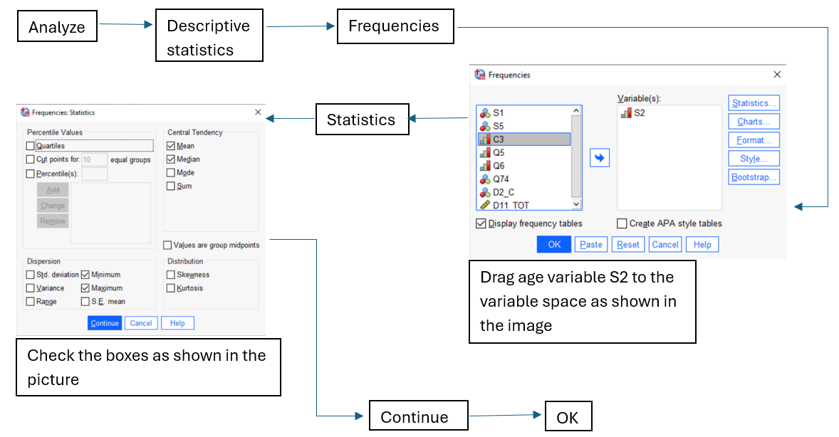
c) Calculating the Frequency Distribution and the Relative Frequency Distribution for the age of the workers;
The process;
Open the SPSS file saved as
UsWorkers.sav and follow the steps as displayed in the image

Slide 9
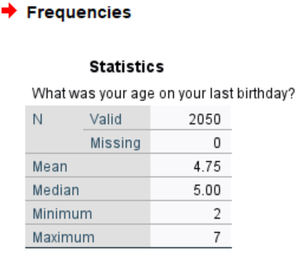
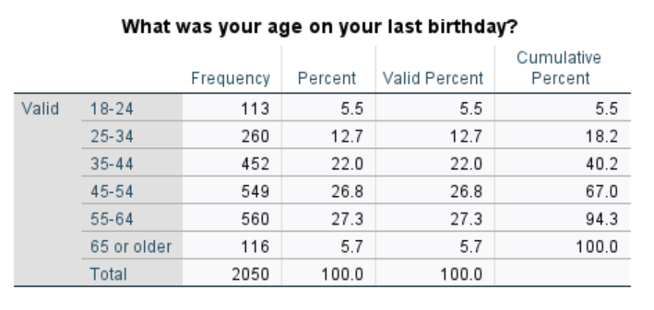
The output and the insights;
From the output tables we can confirm that there are 2050 cases with 0 missing values indicating a perfect sample size for analysis and the minimum code value 2 which indicates that there are no workers under the age of 18.
Furthermore, it is clearly visible that compared to the workforce with ages below 35 and the workforce with ages above 65, the number of workers with the age group ranging from 35 to 64 are significantly higher. They contribute up to 76.1% of the workers, which means that average number of people in the US start their careers roughly at the age of 35.

Slide 10
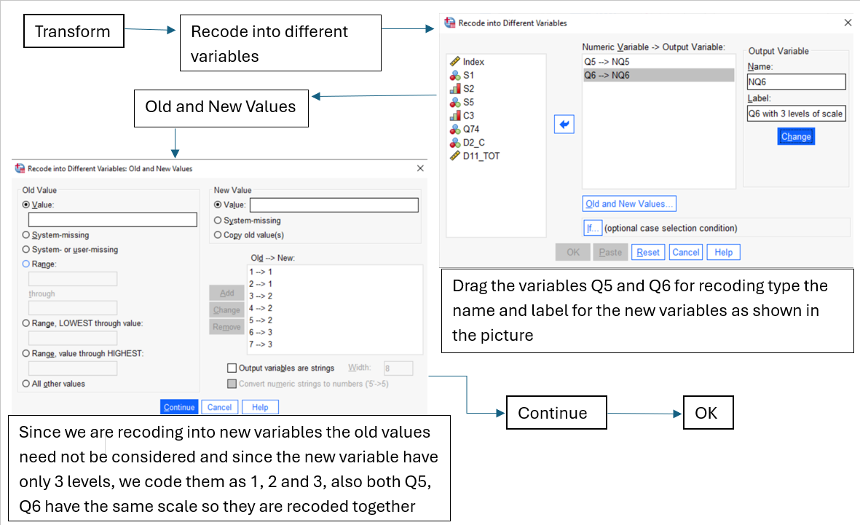
d) Recode variables Q5 and Q6 and calculate the proportion of survey respondents agree that their workplace has both a great performing management and a first class team of workers;
The process;
Open the SPSS file saved as
UsWorkers.sav and follow the steps as displayed in the image

Slide 11
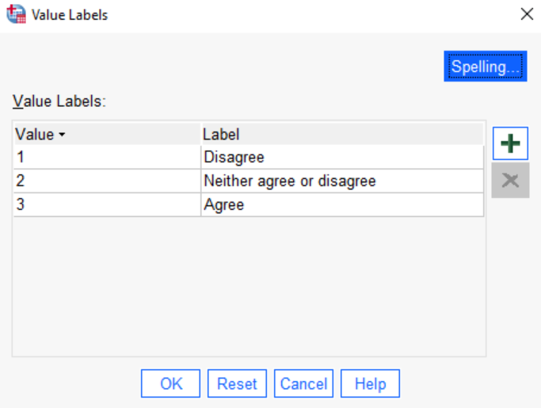
After creating new variables NQ5 and NQ6 adding value labels in the variable view tab of the data editor window for both the variables should be done
To find the proportion of workers agreeing about their workplace having both great performing management and a first class team of workers, we create a new variable combining NQ5 and NQ6 which is called ‘CombinedScale’ and the process to create this variable is followed in the next slide

Slide 12
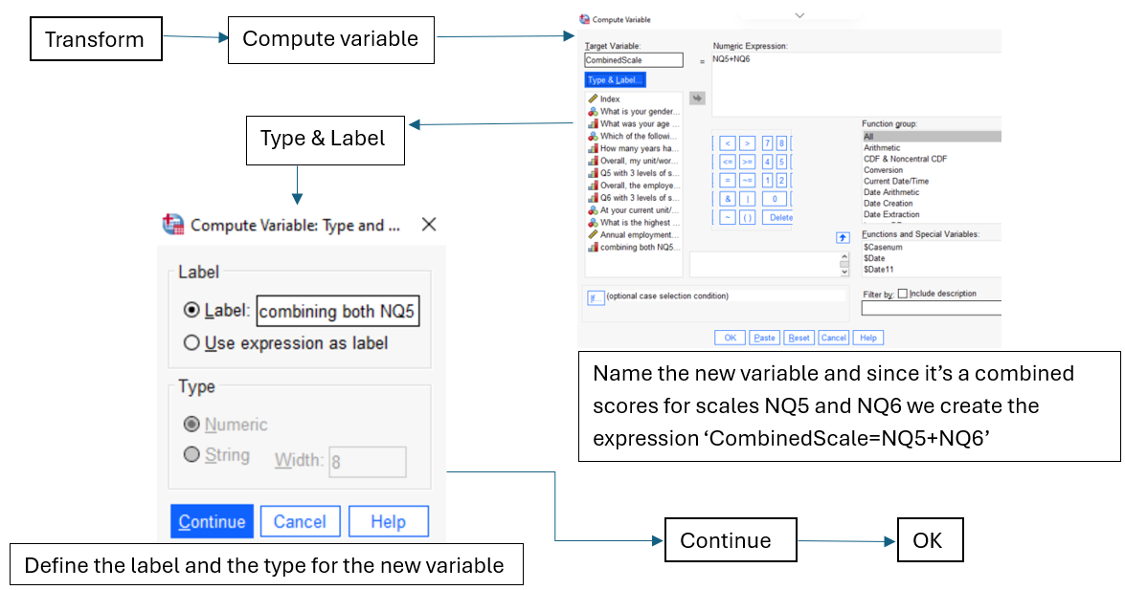
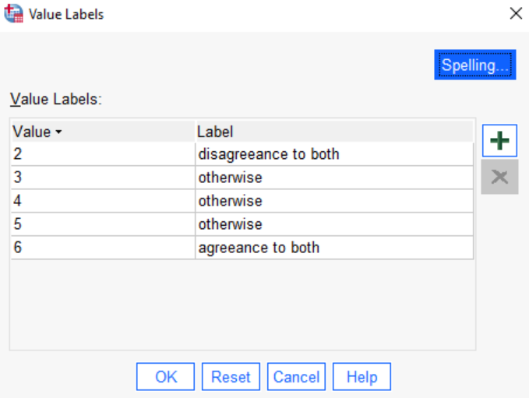
After creating new variable CombinedScale, value labels are added as shown in the image above
For frequencies and percentage follow the steps from question c except you substitute the S2 variable for the CombinedScale

Slide 13
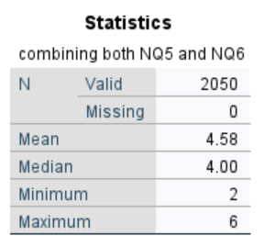
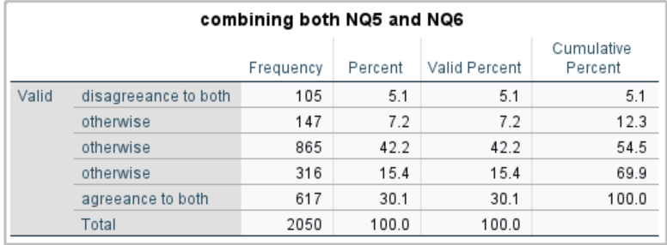
The output and the insights;
30.1% of the workforce who attempted the survey agree that they have both exceptional workers and management teams, 5.1% of the workforce disagree to both the claims and lastly the majority of the workforce(64.8%) have different opinions on each of the claims.

Slide 14
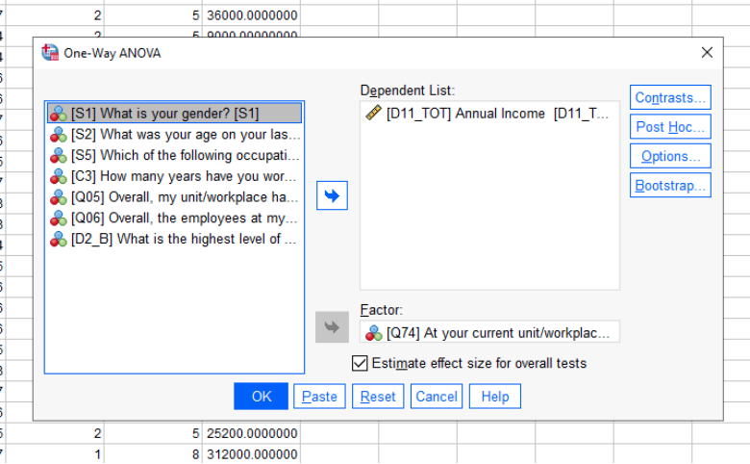
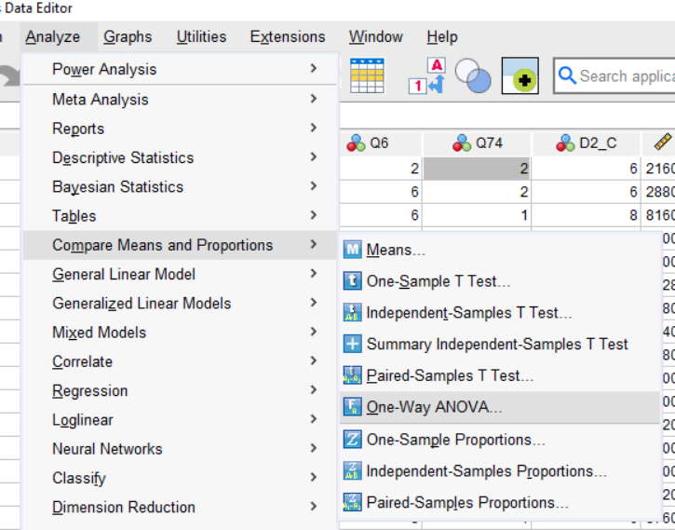
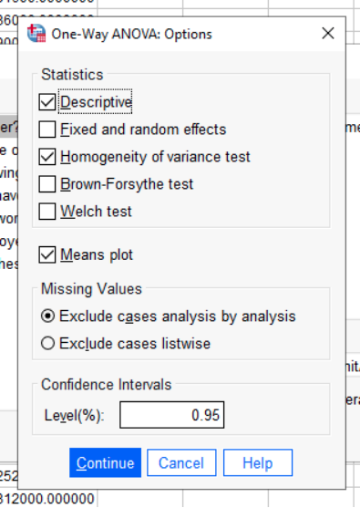
e) Calculate the average annual earnings separately for unionized and non unionized workers. Determine whether there is a statistically significant difference between the annual earnings of unionized workers and non unionized workers;
The process;
5
1
6
2
4
7
8
3
9
11
10

Slide 15
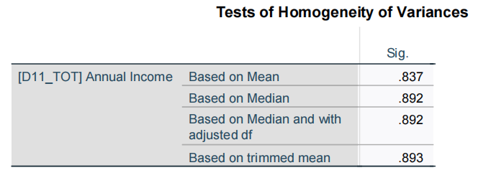
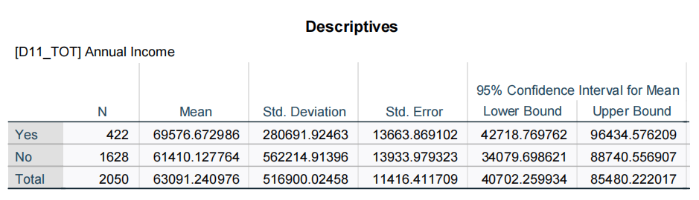
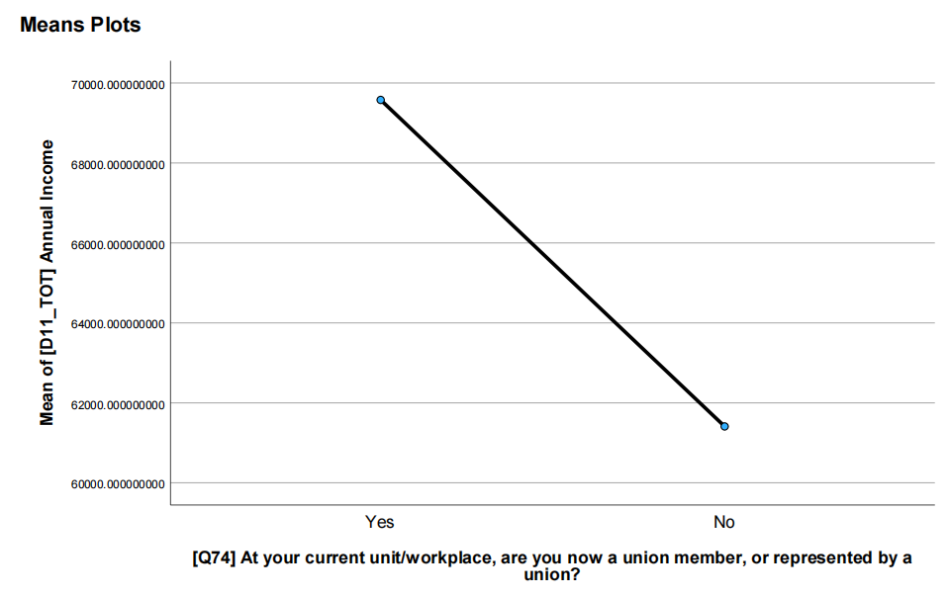
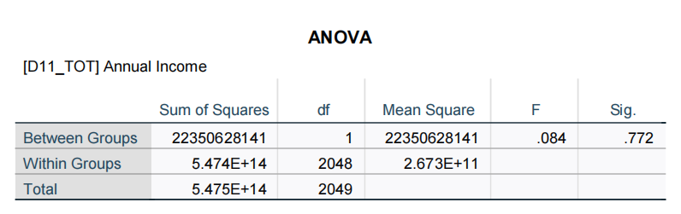
The output and the insights;
The average annual income for unionized workers is £69,576.67
The average annual income for non unionized workers is £61,410.13
The Levene’s test result is not a statistically significant p-value, so the assumption of equal variances is met and we can proceed to the ANOVA results
The ANOVA result is not a statistically significant p-value, therefore we fail to reject the null hypothesis that there is no difference between the means of the groups
  Therefore, there’s no significant difference between the average annual income of unionized and nonunionized workers
  Because of this, there is no need for a post-hoc test; additionally, we are only measuring two groups while a post hoc test would determine degrees of difference between at least 3 groups
A one-way between-groups analysis of variance was conducted to explore the average annual income. Participants were divided into two groups according to their unionized status. There was a statistically insignificant difference at the p value greater than .05 level in the optimism scores for the employment groups.

Slide 16
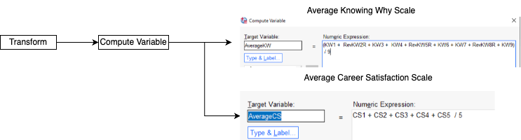
2. Creating Average Summated Scales
The Process;
Opened CareerOutcomes.sav and created 2 new variables:
AverageKW
AverageCS

Slide 17
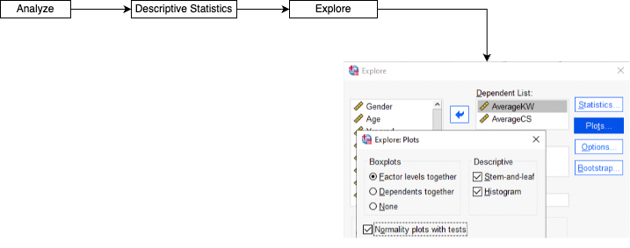
b) Descriptive Statistics for New Scales;
The Process;
Selected newly made scales under “Explore”, and selected Descriptives and Normality plots

Slide 18
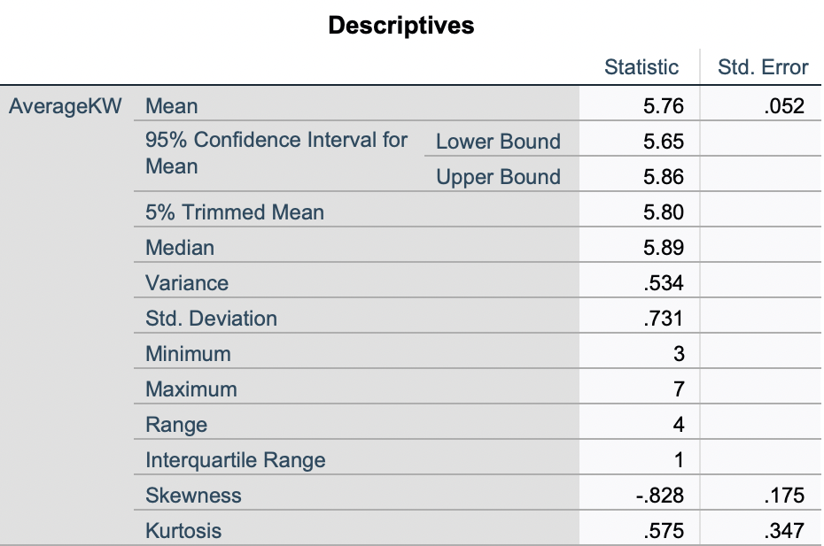
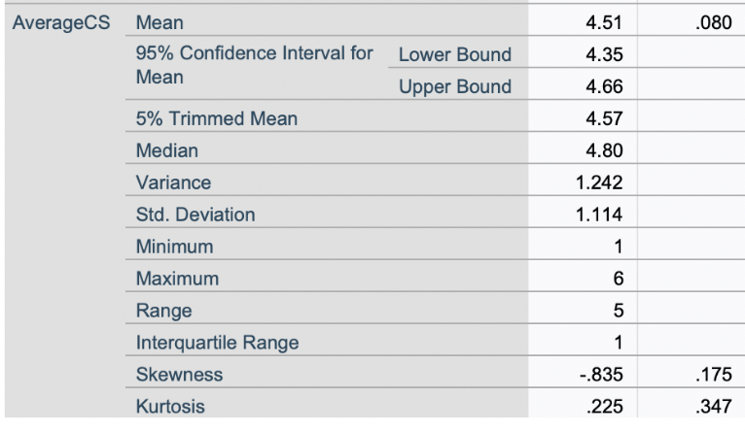
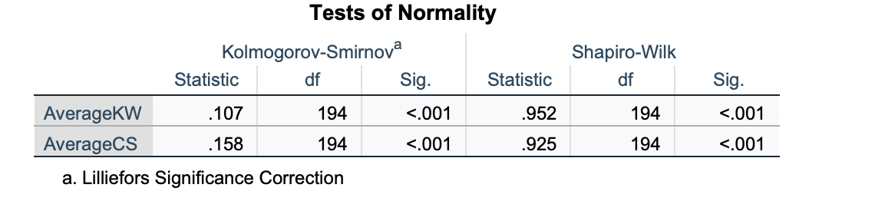
Descriptive Statistics and Normality Tests Output
Descriptive Statistics Overview:
Knowing Why (KW):
Mean = 5.76,
SD = 0.73,
Skewness = -0.828
Data is slightly left-skewed, with most responses between 5 and 6.
Career Satisfaction (CS):
Mean = 4.51, SD = 1.11, Skewness = -0.835
Data is also left-skewed but more spread out.
Normality Tests Results:
Both tests return p-values < 0.001, meaning we reject normality for both KW and CS.

Slide 19
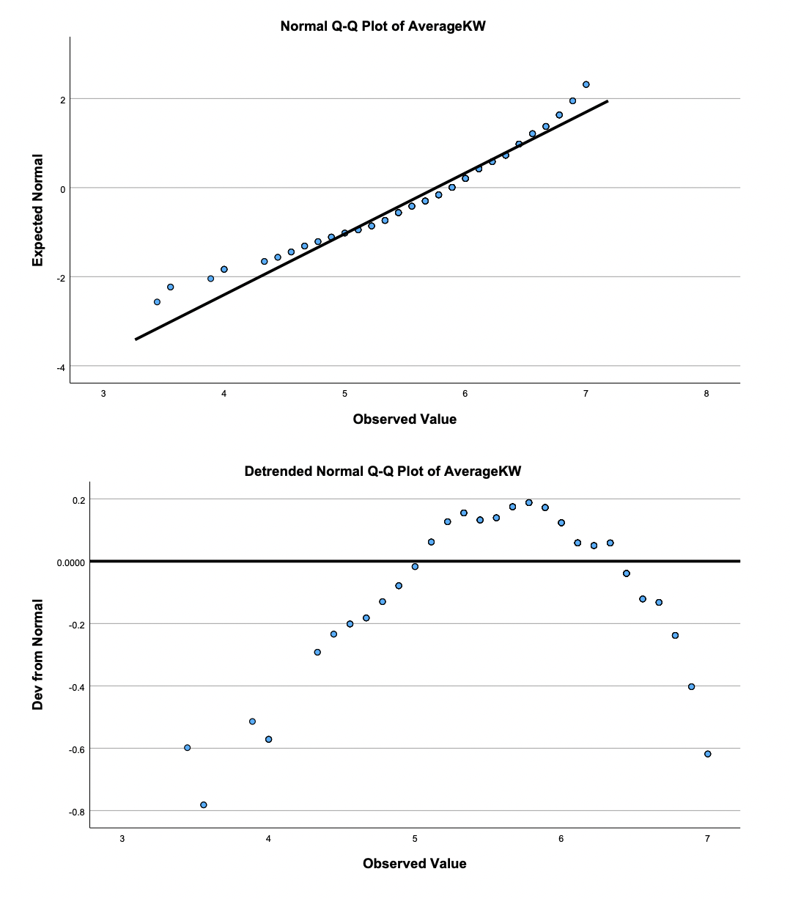
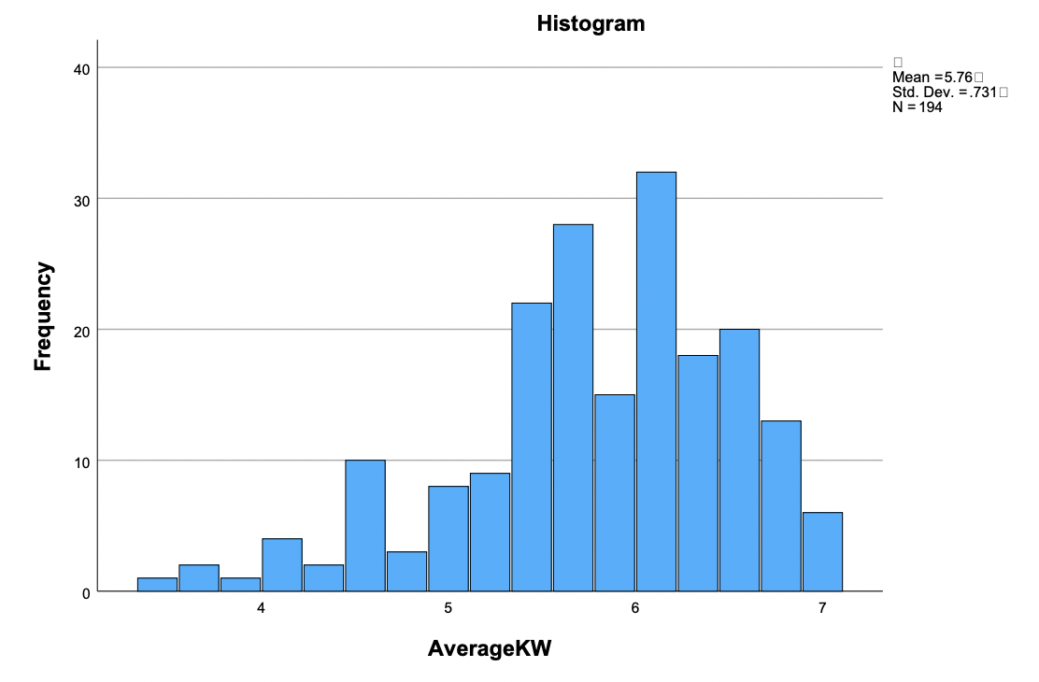
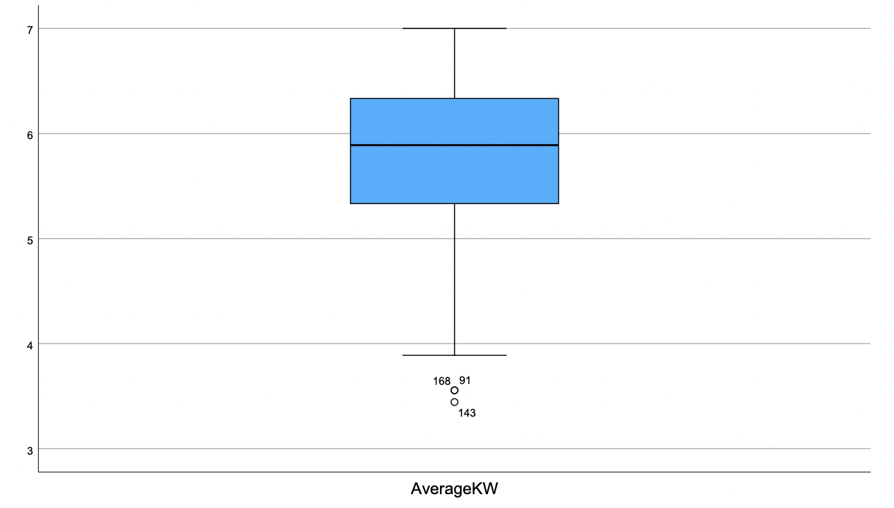
Knowing Why Normality Plots
Histogram:
Slight negative skew, most values are between 5 and 6.
Boxplot: Wider interquartile range with greater variability. Median above center, indicating higher satisfaction.
Q-Q Plot: Deviations from normality, especially at the tails.
Detrended Q-Q Plot: Shows systematic deviations, confirming non-normality.

Slide 20
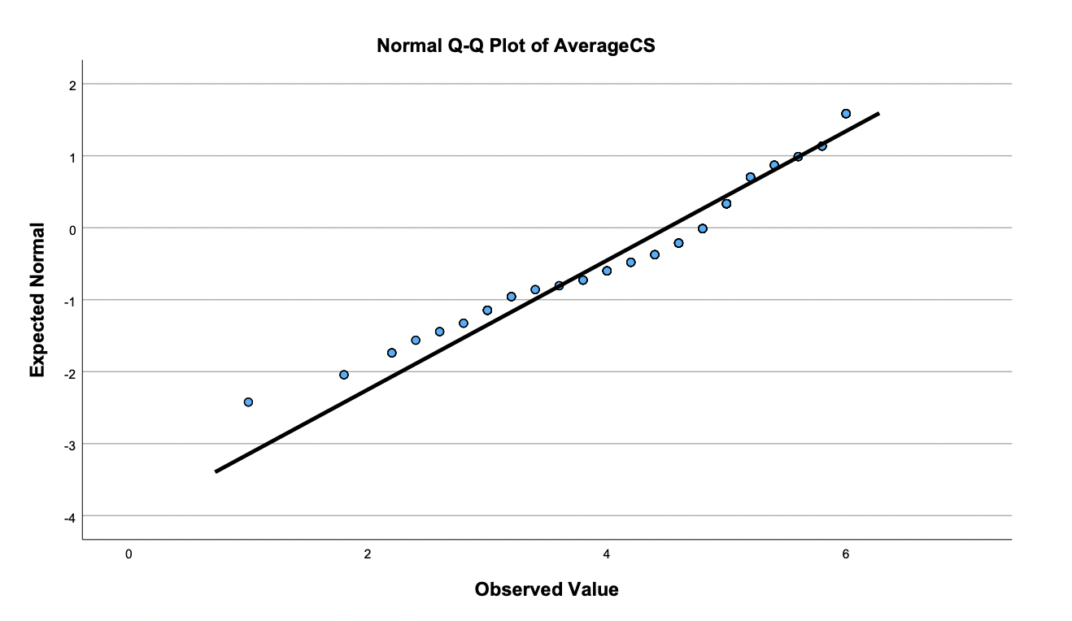
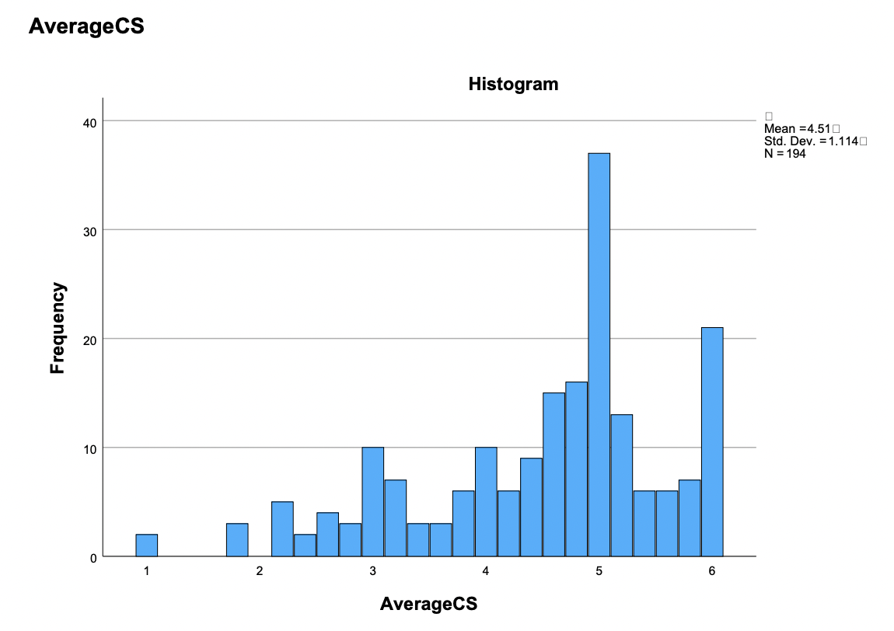
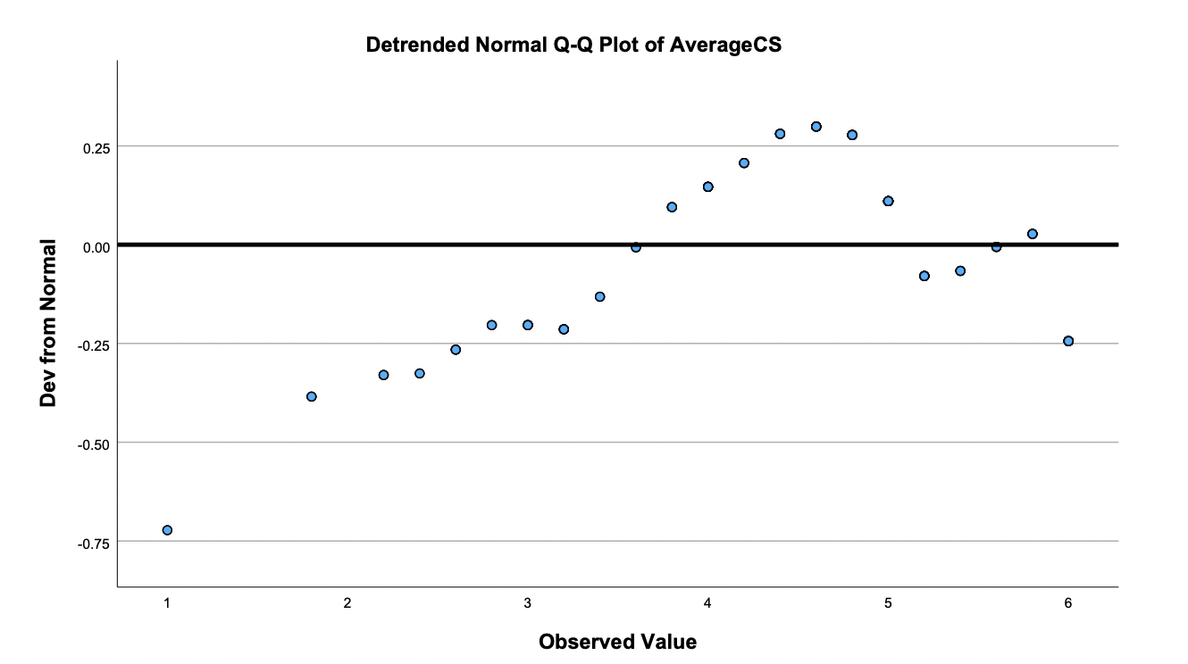
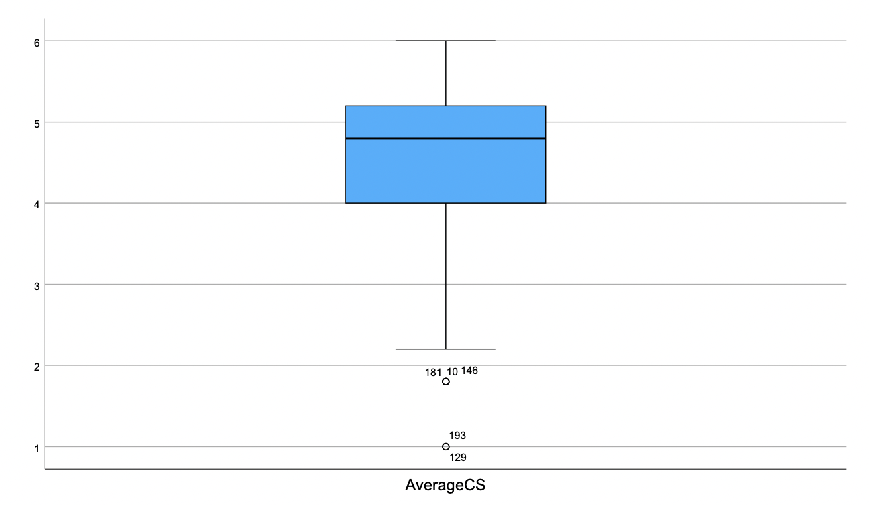
Career Satisfaction Normality Plots
Histogram: Distribution is more spread out, slight negative skew
Boxplot: Wider interquartile range with greater variability. Median above center, indicating higher satisfaction
Q-Q Plot: Deviations at the lower and upper ends.
Detrended Q-Q Plot: Confirms irregular pattern in distribution.

Slide 21
c) Insights and Conclusion;
Both "Knowing Why" (KW) and "Career Satisfaction" (CS) are slightly negatively skewed.
CS has a wider spread of responses, suggesting greater variability in satisfaction levels.
Normality tests confirm that neither variable follows a normal distribution.

Slide 22
Thank You.
Any Questions?

